Slide 1
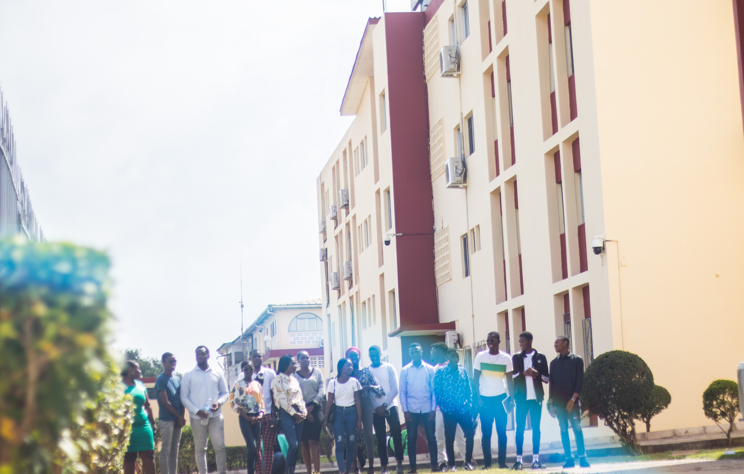
Presentation of an American-Style University:
INTERNATIONAL UNIVERSITY OF GRAND BASSAM
iugb.edu.ci
Notes:
Ladies and Gentlemen, I have the honor to present my report for November 2013 - April 2014

Slide 2
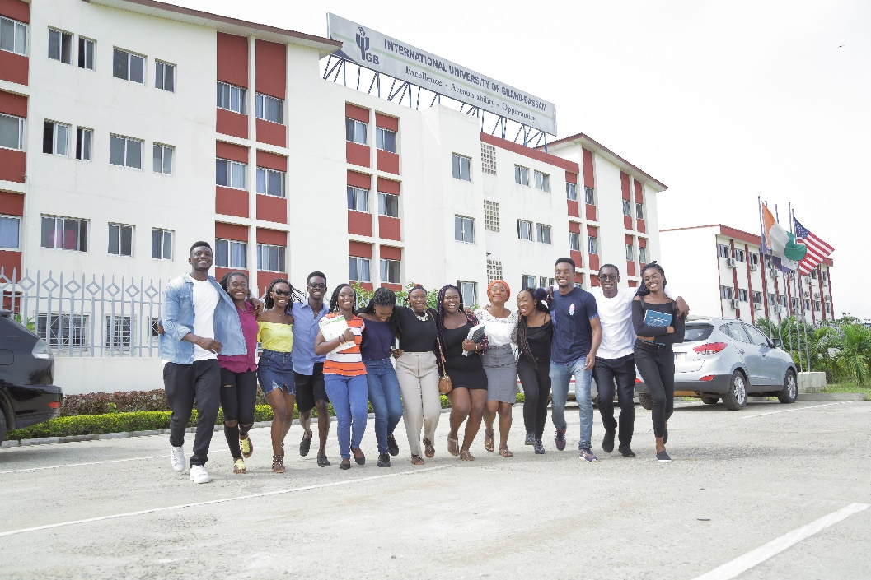
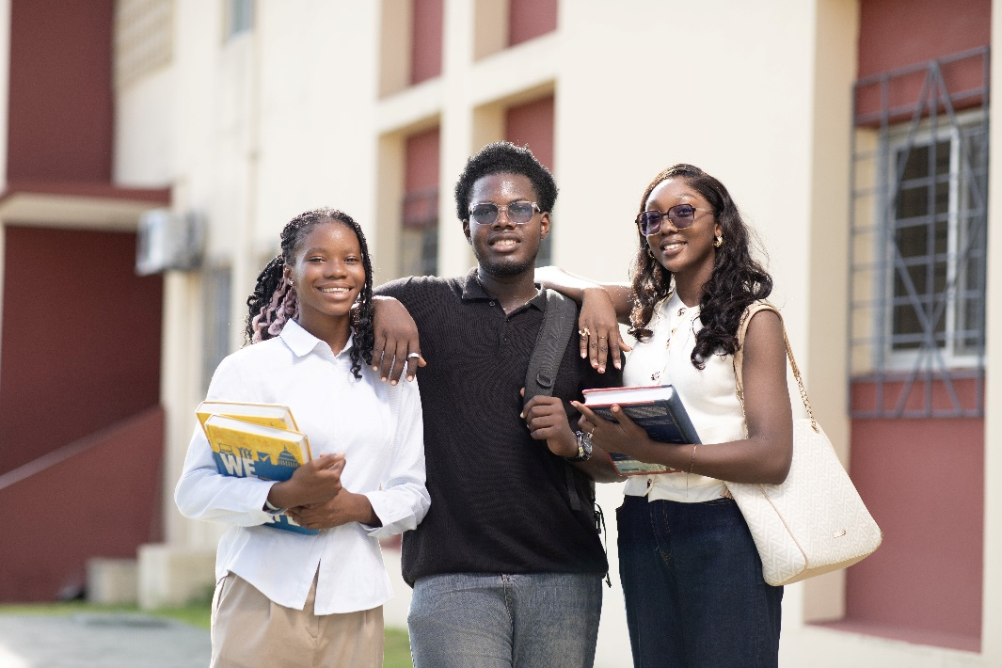
CONTENTS
Notes:
Let’s start with the University at a Glance.

Slide 3
CONTENTS
1. IUGB: Presentation and Location
2. Special features
3. Academic Programs
4. Student Life
5. Partnerships
6. Admissions

Slide 4

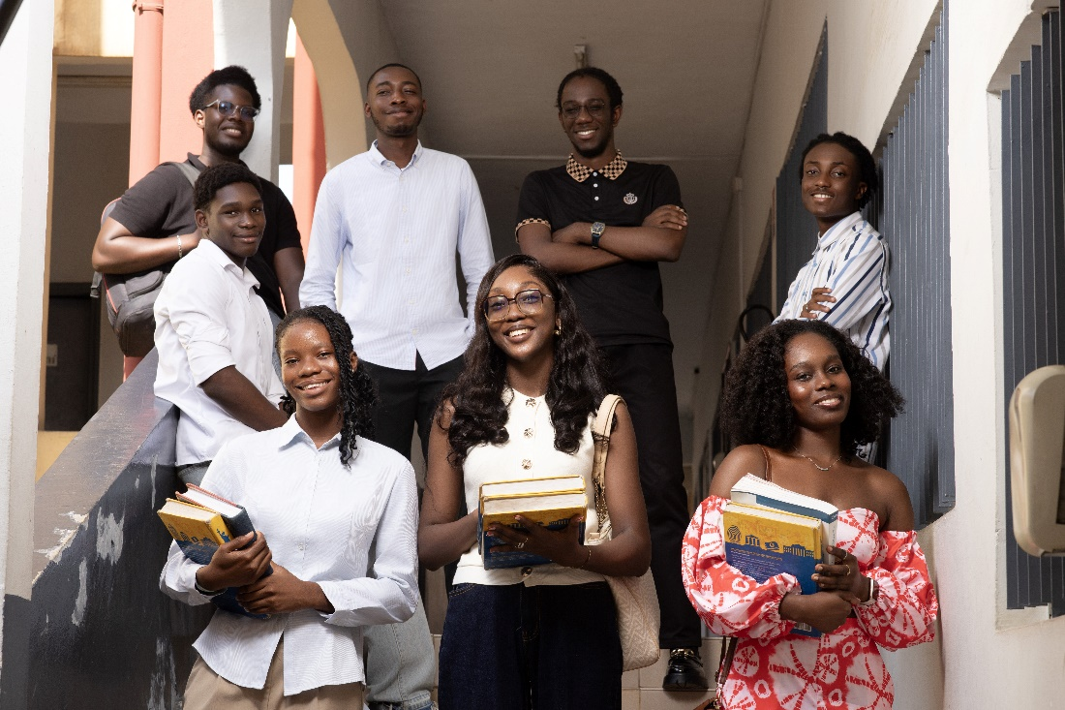
IUGB : PRESENTATION AND LOCATION
1
Notes:
Let’s start with the University at a Glance.

Slide 5
Presentation
Established by an educational agreements existing since 1994 between the Government of Côte d’Ivoire and the State of Georgia U.S.
IUGB is a private, publicly, student-centered institution driven by a will to train well-educated students that will compete and lead in global environment.
Created by university charter (decree no. 2007-477 of May 16, 2007)
First president of IUGB, Professor Saliou Touré inaugurated May 18, 2007

Slide 6
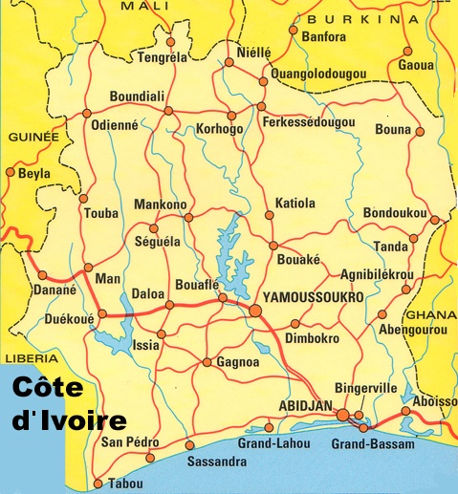
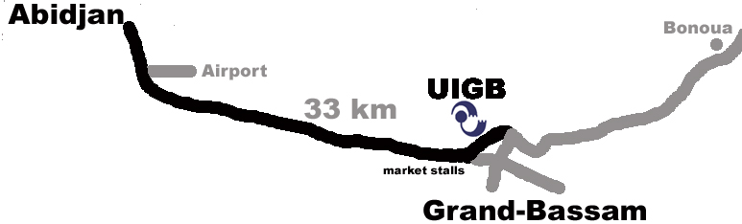
Location
Located in the Coastal city of Grand-Bassam
Easily accessible by air, road
Developed city & beach amenities nearby

Slide 7
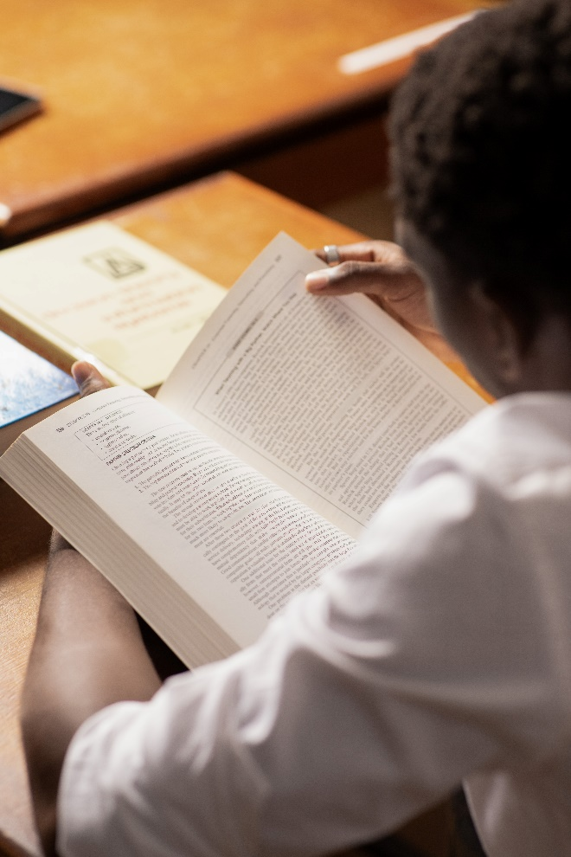

SPECIAL FEATURES
2
Notes:
Let’s start with the University at a Glance.

Slide 8
American –Style University
An American type university based on credit units
English as the language of instruction and work
Intensives English courses in the University Preparatory Program
International environment
Student Exchange Programs with Universities Partners
Degree-granting Institution

Slide 9

ACADEMIC PROGRAMS
3

Slide 10
Schools and Training Programs
Undergraduate Preparatory Program (UPP): English
School of Science, and Engineering (SSE): BSCSC, BSMTH, BSMET, BSPE, BSME, BSAI, BSSWECSC, BSDS
School of Business and Social Sciences (BSS): BBA, BSCIS, BAPOL, BSECO
Center for Continuing Education (CCE): Special programs for individuals and companies

Slide 11
Academic Units and Programs
SSE
Bachelor of Business Administration (BBA)
English Language for IUGB Students
UPP
BSS
BS in
Computer Science (BSCSC)
BS in
Petroleum Engineering
(BSPE)
BS in
Mining Engineering
(BSME)
BS in
Artificial Intelligence (BSAI)
BS in Mathematics (BSMTH)
BA in
Political Science (BAPOL)
Remedial Mathematics
Foundations for Academic Success
BS in Computer Information Systems (BSCIS)
BS in
Data Science
(BSDS)
BS in Economics
(BSECO)
BS in Software Engineering and Computer Science
(BSSWECSC)
BS in Mechanical Enginnering Technology
(BSMET)
CCE
Staff Development Programs for Companies
English Language for Professionals
English Language for Students

Slide 12
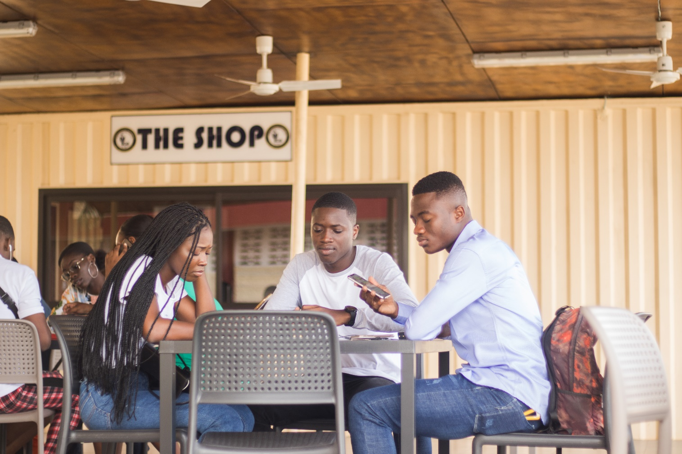
Students life
4

Slide 13
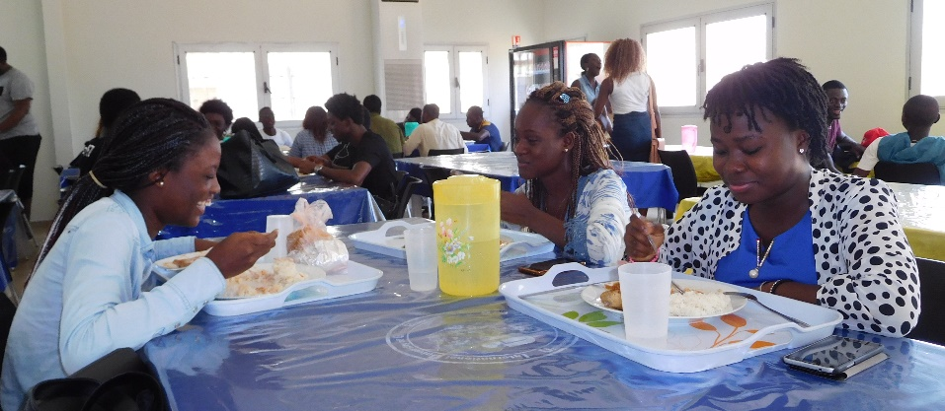
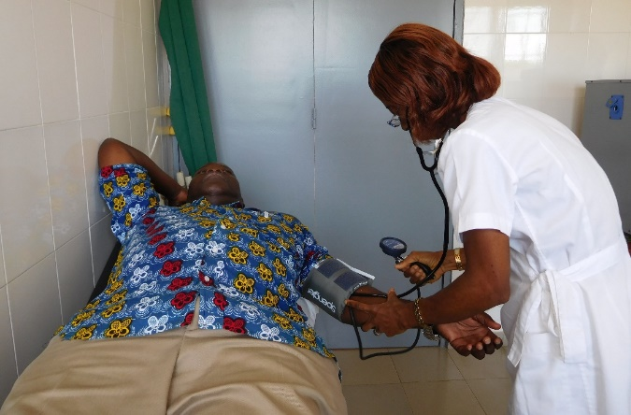
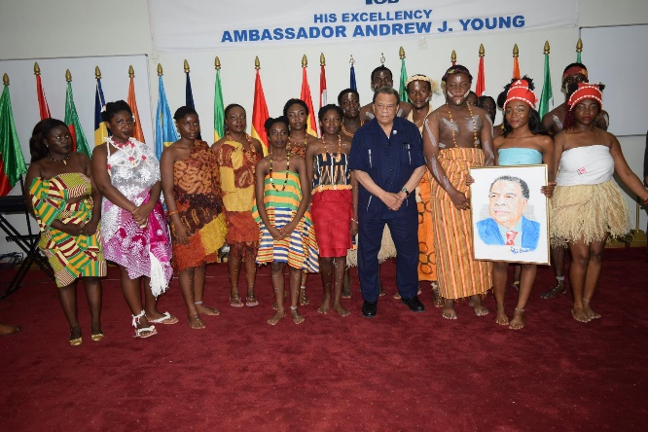
Student Services
Office Hours by faculty
Advising and Mentoring
Housing and Residential Life
Dining Hall
Transportation
Medical Center
Security and Safety
Career Placement
Student Clubs: Business, Information Technology, Law, Music, Political Science, Religious, Science, Speech

Slide 14
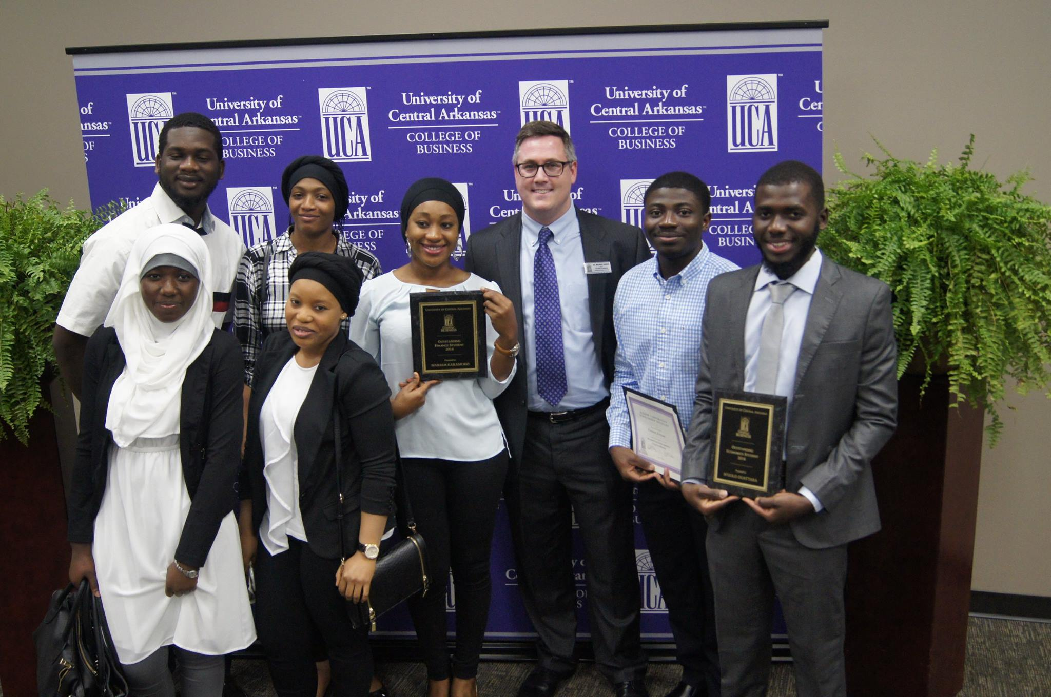
Partnerships
5

Slide 15






Universities Partners
Georgia State University, Atlanta, Georgia, USA
University of Houston, Houston, Texas
University of Alabama at Birmingham, USA
University of Central Arkansas , USA
Minnesota State University Mankato, USA
Montclair State University, New Jersey, USA

Slide 16

Admissions
6

Slide 17
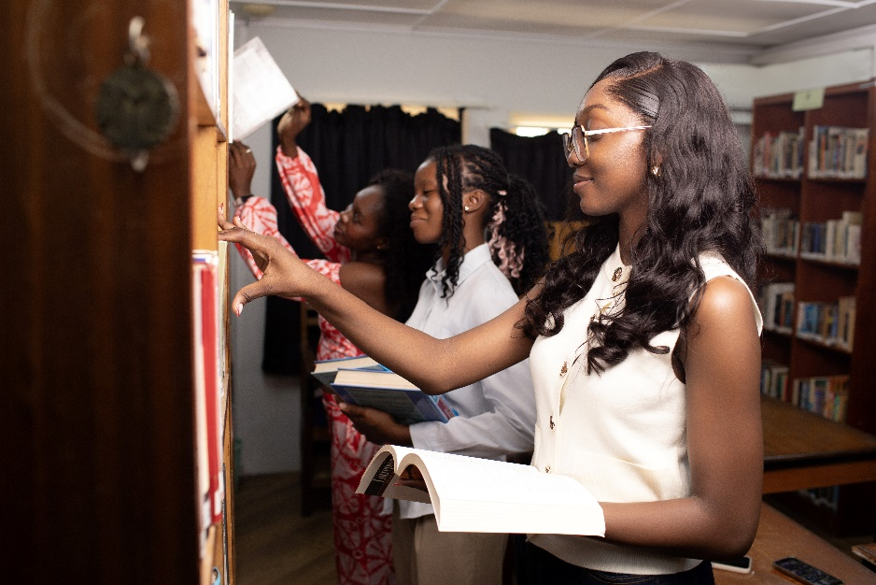
Student Admission Requirements
“Baccalauréat” or equivalent
SAT Critical Reading and Math scores totaling 1100 (500 math)
Placement test of English (TOEFL: 71 IBT, 530 ITP/PBT, 5.5 IELTS)
Review of grade reports from high school or higher education institutions

Slide 18
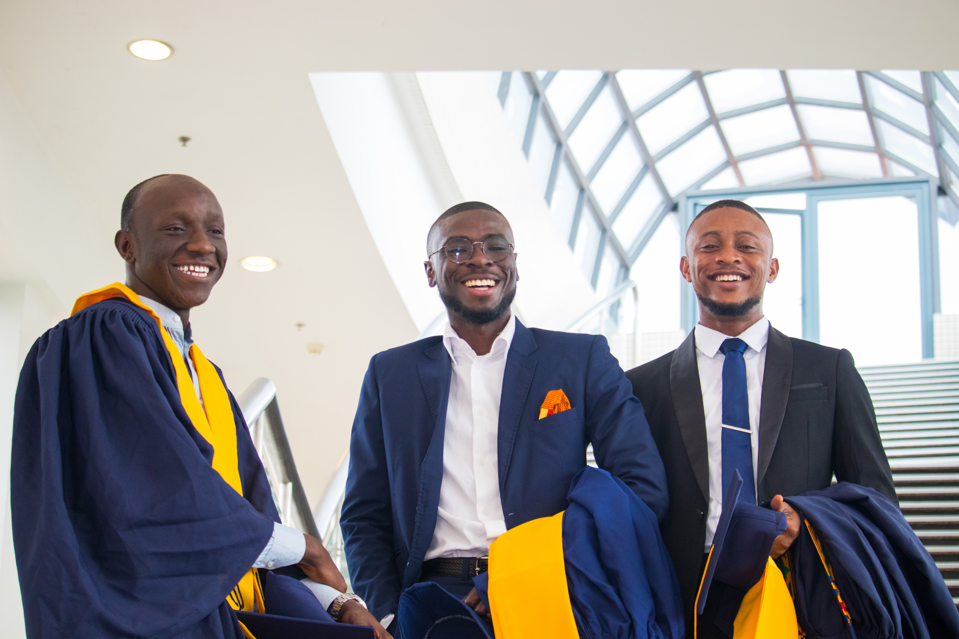
Thank You!
Contact:
Grand-Bassam
Tel. : +225 27 21 30 36 40/Fax : +225 27 21 30 34 83
Abidjan
Tel: +225 27 22 41 30 41/+225 05 55 97 04 97/05 45 95 49 11
Email : admissions@iugb.edu.ci/ info@iugb.edu.ci
Site web : www.iugb.edu.ci
www.iugb.edu.ci
Notes:
A lot of what we do at IUGB would not be possible without the vision and execution of our faculty, students, staff and you. Thank you and for your attention.

